Slide 1
I Love You, Lord, But ...

Slide 2
Passing the Torch
Mighty in the Word of the Lord
Spiritual Direction
Retreats
Bible Teachings

Slide 3
Passing the Torch
Mighty in the Word of the Lord
with The Rev. Mrs. Dr. Carolyn Cole
Spiritual Director/Retreat Master/Bible Teacher

Slide 4
I Love You, Lord, But . . .

Slide 5
Credits
Scriptures are from the KJV from E-Sword Electronic Bible
Pictures are from Communication Resources, Inc. (Scripture Art)
Written materials are those of The Rev. Mrs. Dr. Carolyn Cole,
Retreat Master / Christian Spiritual Director / Bible Teacher

Slide 6
I Love You, Lord, But . . .

Slide 7
What do I do with my feelings?

Slide 8
Love
Joy
Peace
Long-Suffering
Gentleness
Goodness
Faith
Meekness
Temperance
fearful
King David
St. Paul
Helpless
ANGRY
Sorrow
useless
John the Baptizer
discouraged
Jeremiah
Abused
Mary
Lost
USED
Job
Miriam
Rejected
Depressed
The People of the Way

Slide 9
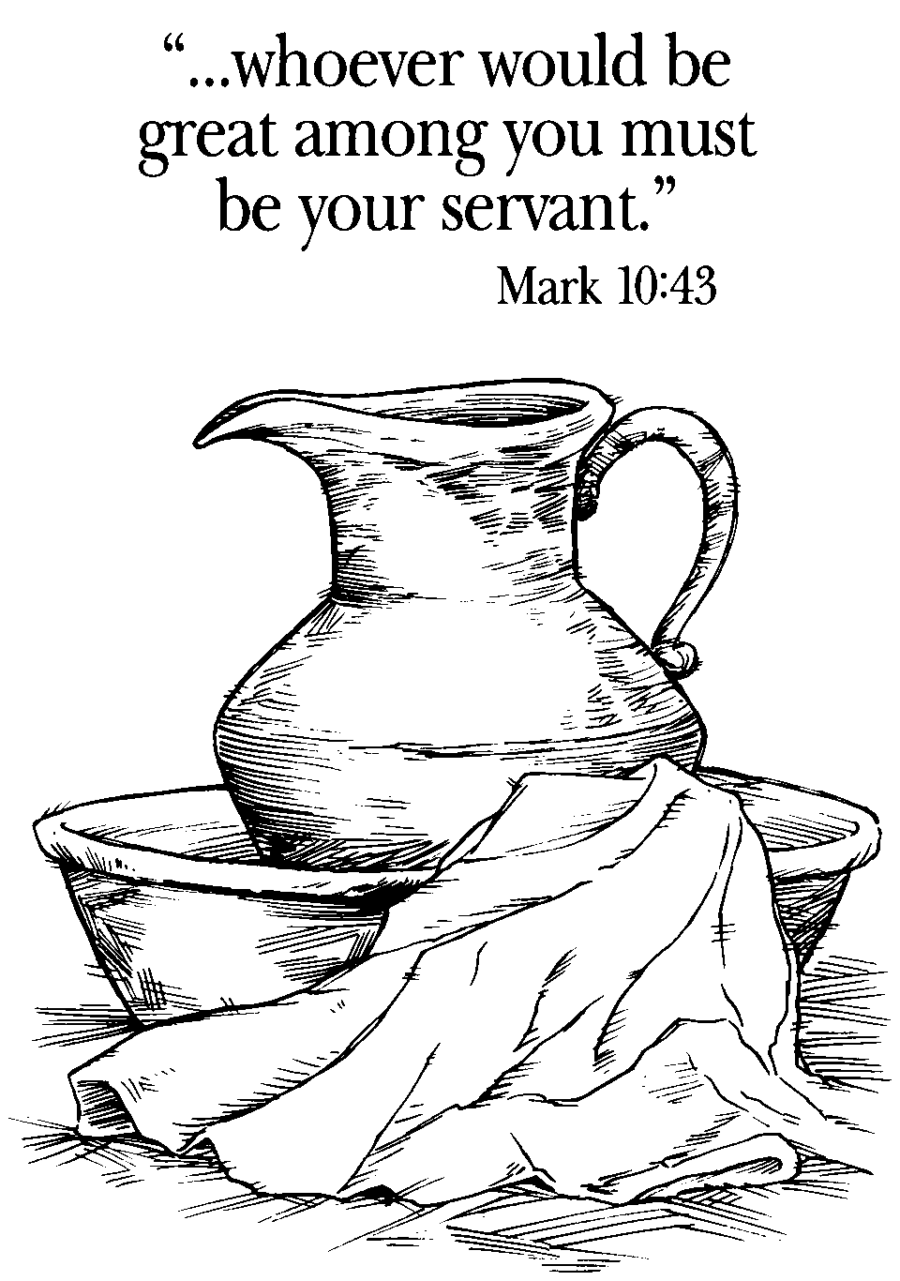
Communication Resources, Inc. (Scripture Art)

Slide 10
Schedule
AS WE COME TOGETHER . . .
Let us:
9:00 AM . . . . . . . . . . . . . . . .Greet One Another
9:30 AM . . . . . . . . . . . . . . . . .Share A Life Map
10:15 AM . . . . . . . . . . . . . . . . . . .Group Sharing
10:45 AM . . . . . . . . . . . . . . . . . . . . . . . . Praying
11:00 AM . . . . . . . . . . . . . . Express Our Feelings
11:30 AM . . . . . . . . . . . . . . . . . . . . . . . . . . Lunch
12:30 PM . . . . . . . . . . . Look at Our Glass Flask
1:15 PM . . . . . . . . . . . . . . . . . . . . . . . . . . . Break
1:30 PM . . . . .Walk with A Biblical Character
2:00 PM . . . . . . . . . . . . . . . . . Take A Boat Ride
2:20 PM . . . . . . . . . . . . . Share The Experience
2:45 PM . . . . . . . . . . . . . . . . . . .Close in Prayer

Slide 11
How to Walk with the Lord Jesus
The Gospel of Matthew gives us some insight in living the Christian life. It is indeed a life set apart from the world, walking differently, thinking differently, experiencing life differently as we live in the world, but not be of the world.

Slide 12
How to Walk with the Lord Jesus
Matthew 9 and 10 tells us how Jesus walked while with His disciples.
Matthew 9.9 says, “As Jesus was walking along . . .”
Matthew 9. 10 says, “as he sat at dinner . . .”
Matthew 9.12 says, “When he heard this . . .”
Matthew 9.18 says, “While he was saying these things . . .”
Matthew 9.23 says, “When Jesus came to the leader’s house . . .” Matthew 9.27 says, “As Jesus went on from there . . .”
Matthew 9.30 says, “Then Jesus sternly ordered them . . .”
Matthew 9.35 says, “Then Jesus went about all the cities . . .” Matthew 9.37 says, “Then he said to his disciples . . .”
Matthew 10.1 says, “Then Jesus summoned his twelve disciples . . .”

Slide 13
How to Walk with the Lord Jesus
Listen carefully to Matthew 10.7:
“As you go, proclaim the good news,
The kingdom of heaven has come near. Cure the sick, raise the dead, cleanse the lepers, cast out demons. . . .”

Slide 14
How to Walk with the Lord Jesus
So, how do you live a Christian life? Deuteronomy 6.4-9 says it well.

Slide 15
How to Walk with the Lord Jesus
“Hear, O Israel: The Lord is our God, the Lord alone.
You shall love the Lord your God with all your heart, and with all your soul, and with all your might.
Keep these words that I am commanding you today in your heart.
Recite them to your children and talk about them when you are at home and when you are away, when you lie down and when you rise.
Bind them as a sign on your hand, fix them as an emblem on your forehead,
and write them on the doorposts of your house and on your gates.” Deuteronomy 6.4-9

Slide 16
Praying with Pen
Here I am, Lord,
What do you want of me?

Slide 17
The Commission is Given
Go in the Name of the Lord God this day, for you have been chosen, you have been called to go down to where the rubble is.
When the Lord your God brings you to the Mountain top, when He refreshes you, when He lifts you to a higher plane, when He takes you unto Himself – into His bosom, it is then that you are crushed so that the fragrance of His love can be experienced as you go back down the mountain to where the rubble is.
This is not a work that you can do of your own, but a work of His through you as the fragrance of His love draws others to you so that you may share the Good News of Jesus Christ, the Great Physician, who died for our sins that we may come to wholeness and holiness in Him and become a new creation in Christ Jesus. The Reverend Dr. Carolyn Cole

Slide 18
Let Us Go Forth in the Name of the Lord Jesus Christ
To Serve
To Love
To Worship

Slide 19
Feed my sheep

